Slide 1
The Magician’s Nephew
By C.S. Lewis
PowerPoint by ______

Slide 2

Chapter 1:The Wrong Door
Polly is a little girl who lives in a row house with her parents.
All her friends are away for the summer. So one day she saw a little boy, she asked him, “What is your name?” Then he replied “Digory.”
Digory is a curious boy who lives in a row house with his aunt and uncle because his dad is away in India and his mom is terribly sick, and is about to die.
Digory’s uncle’s name is Andrew. Digory thinks Uncle Andrew is a very scary and crazy man.
Aunt Letty is Uncle Andrew’s sister. She hates it when Uncle Andrew doesn’t listen to her.
Digory and Polly decide to explore the row house. Then they saw an empty room. When they walked in they saw Uncle Andrew.

Slide 3

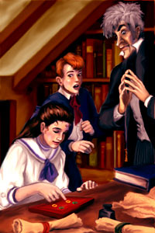
Polly heard a noise. She thought it was coming from the rings. But Uncle Andrew said it couldn’t be coming from the rings.
Uncle Andrew asked Polly to touch a yellow ring. Digory warned her not to, but it was to late.
In a second she disappeared.

Slide 4

Chapter 2:
Digory and his Uncle
Digory asked his uncle where did Polly go.
Then Uncle Andrew explained to Digory that Polly was in a different world.
Uncle Andrew said the yellow rings take you to the world and the green rings bring you back to your world.
Then Digory decided to go save Polly. So he put two green rings in his pocket and he put on a yellow ring on his finger. In a second he disappeared.

Slide 5
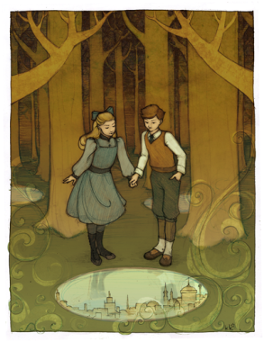
Chapter 3:The Wood Between Worlds
When Digory got there he realized he had just come out pool of water. In each pool he could see a city.
Digory thought that its like a tunnel between the worlds.
Then he saw a little girl walking around the woods. He realized that it was Polly.
They decided to go explore the other worlds. So before they left they marked the pool that leads them back home.

Slide 6
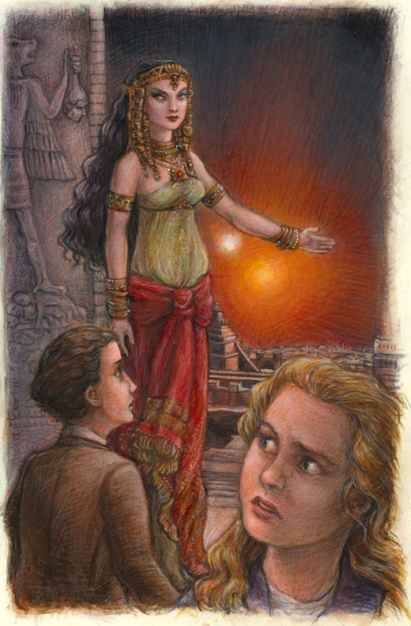
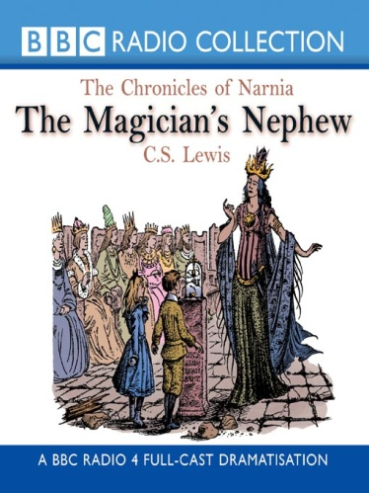
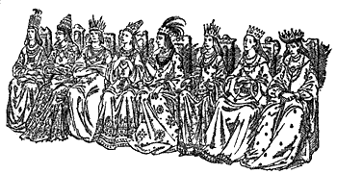
Chapter:4 The Bell and the Hammer
When they entered the new world the saw that the people were statues.
At the beginng of the great hall the people were very happy and calm. But as they got further down they looked mean and angry and rich.
At the very end was sitting a very mean looking queen in her throne.

Slide 7
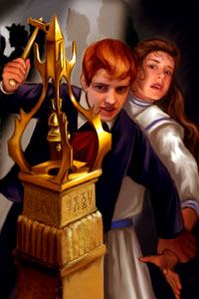
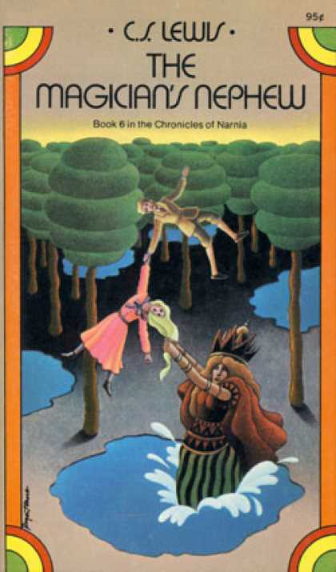
Chapter:5 The Deplorable Word
In front of her was a poem saying: Make your choice, adventurous Stranger; Strike the bell and bide the danger, Or wonder, till it drives you mad, What would have followed if you had.
Digory decided to strike the bell, but Polly didn’t want to.
But Digory did it anyway.
Then the queen woke-up. She thought Digory was a servant of a magician.
She said
She wanted to go back to London to rule it.
They tried to escape, but she was touching Polly’s hair.

Slide 8

Chapter 6:
The Beginning of Uncle Andrew’s Troubles
When queen Jadis was in London ,she treated Uncle Andrew like her servant.
She asked him to do every thing for her.
Digory was scared that Jadis might ruin his world.

Slide 9
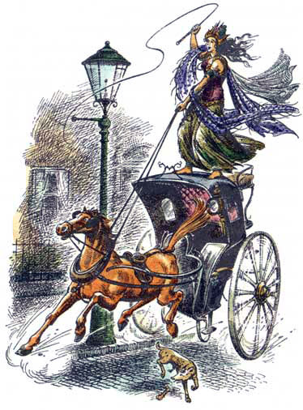
Digory thinks he should bring Jadis back to her world.
Digory over heard Aunt Letty talking to some lady about the fruit of youth, could save his mother.
When Digory looked out the window he saw Jadis whipping the horse like crazy. She was also whispering maddening things to it.
Cabby the owner of the horse was calming the horse named Strawberry.
Then a crowed appeared to see what was going on. A fat man accused Jadis for stealing jewelry.
Then the police man questioned Uncle Andrew about Jadis.
Digory brought the rings and touched Jadis.
Chapter 7:
What Happened at the Front Door

Slide 10

Chapter:8
The Fight at the Lamp-Post
When Polly and Digory put on the rings they were touching Strawberry, Cabby ,Jadis , and Uncle Andrew.
In the new world it was so dark and cold.
Then all a sudden they heard a voice.
Uncle Andrew and Jadis didn’t like the voice.

Slide 11
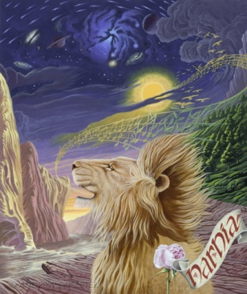
Chapter 9:
The Founding of Narnia
That same voice created the trees and plants and everything else.
Then they realized it was a lion who was creating this new world.
Jadis flung a iron bar [that she had from a lamp-post back in London]at the lion’s head.
But the lion didn’t even feel it. It was like she didn’t even throw it at him.
Then Jadis ran away because she was scared of the lion.
The iron bar had sunk into the ground and was growing into a tree.
Digory hoped this was the land of youth, so his mother would be cured.
Then the lion chose a couple of animals and touched their noses.

Slide 12
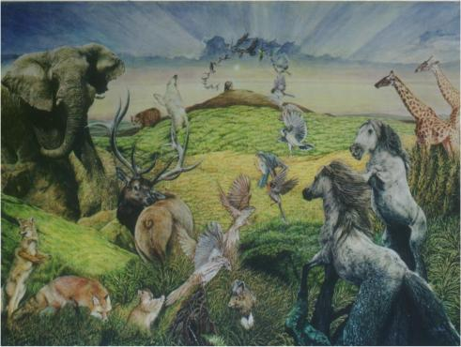
The Lion’s name is Aslan.
Aslan said to those couple of animals “Don’t go back to your Foolish ways. Now you can talk and think. Strawberry was one of them.
Aslan said evil has already come into Narnia.[By that he meant Jadis]
Uncle Andrew tried to make himself believe that the animals weren't talking or laughing because he was scared.
Chapter10:
The First Joke and Other Matters

Slide 13
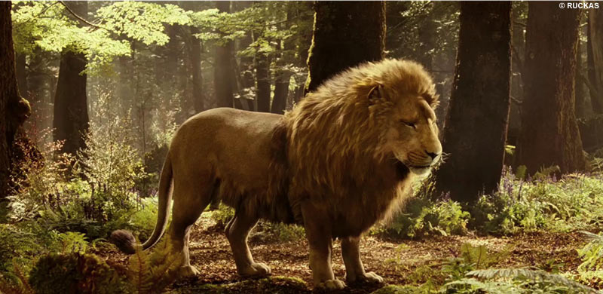
Chapter 11:
Digory and His Uncle Are Both in Trouble
    The Cabby wanted Nellie [his wife] to join him in Narnia.
So Aslan brought her into Narnia by magic.
Some of the animals thought that Uncle Andrew was a pet. So they tried to feed him and they made a cage for him.

Slide 14
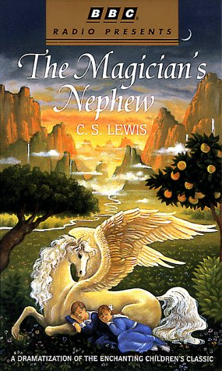
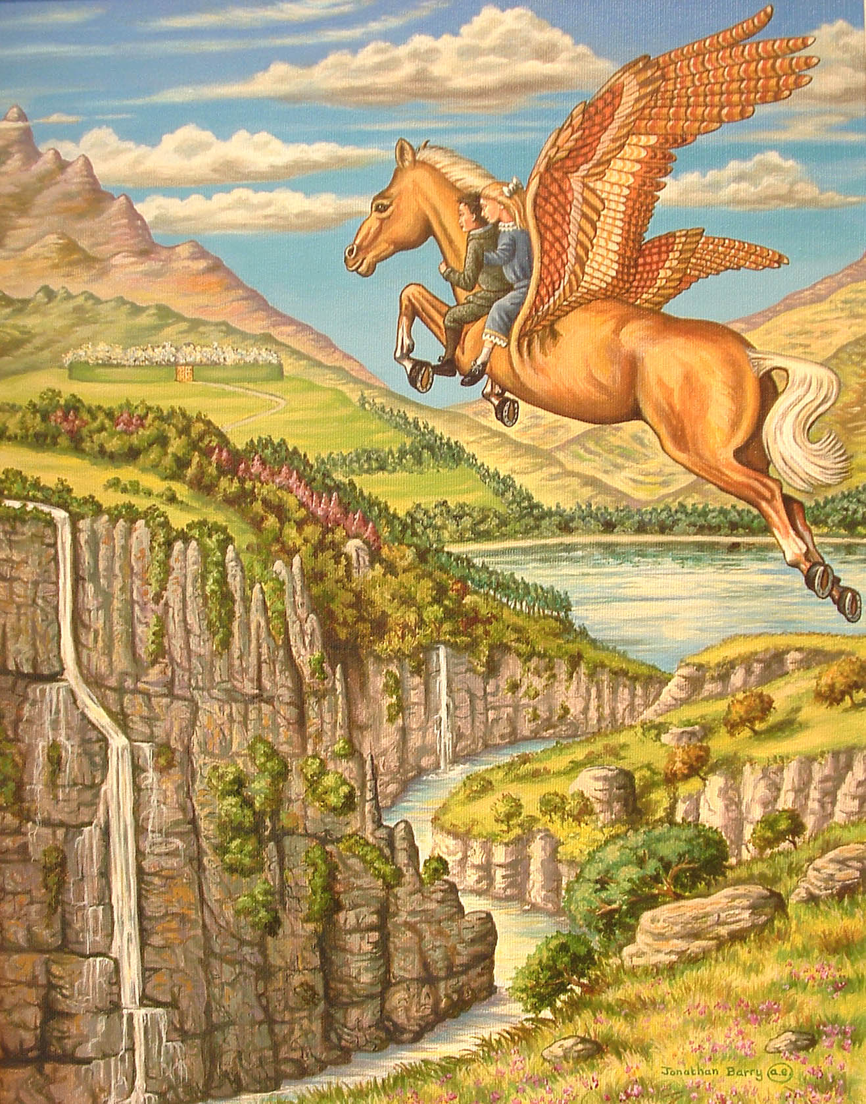
Chapter 12:
Strawberry’s Adventure
Digory asked Aslan to help
his mother to heal.
Then Aslan said to Digory to go get a apple from a different country .
So he gives Strawberry wings and changes Strawberry’s name to Fledge.
So Polly, Digory, and Fledge started their journey.
They flew over valley mountain and waterfalls.

Slide 15
Chapter 13:
An Unexpected Meeting
When they got there they saw a quote that said: Come in by the gold gates or not at all, Take my fruit for others or forbear, For those who steal or those who climb my wall Shall find their heart’s desire and find despair.
So they decided to walk in. So when they did they saw Jadis.
Jadis tried to make Digory take the apple and leave Narnia, with out Polly.
Just then Digory thought that the witch wanted him to disobey Aslan.

Slide 16
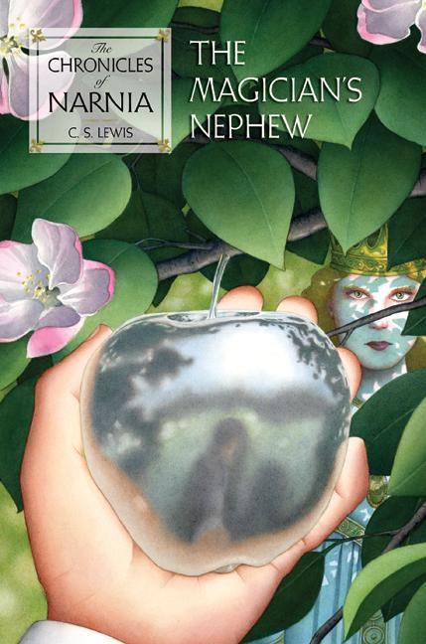
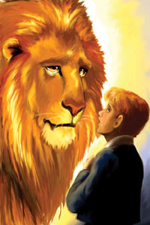
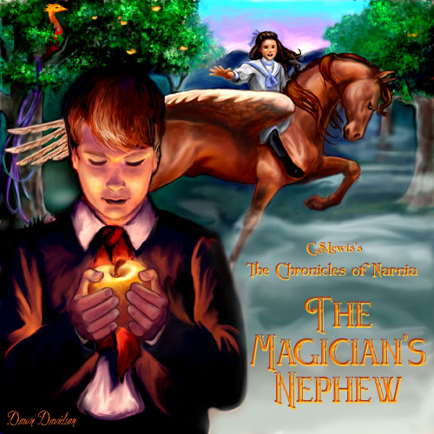
Chapter 14:
The Planting of the Tree
When they got back Aslan asked Digory to throw the apple by the river bank where the ground is soft.
Then the Apple grew into a tree.
Aslan said that this tree will protect Narnia By its sweet smell. So that evil can’t stand this smell.
Aslan told Digory to take an apple for his mother.

Slide 17

Chapter 15: The End of this Story and the Beginning of All the Others
Then the Digory’s mom ate the apple and got better.
Then Polly and Digory buried the rings and the apple core.
Uncle Andrew also realized his mistake and never touched the rings again.
Plus Digory’s dad's uncle died and gave them lots of money so they moved in the heart of the country in a Large hose.

Slide 18
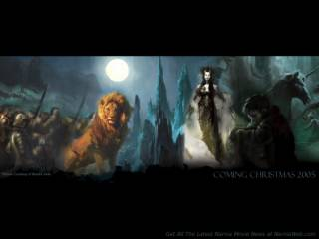

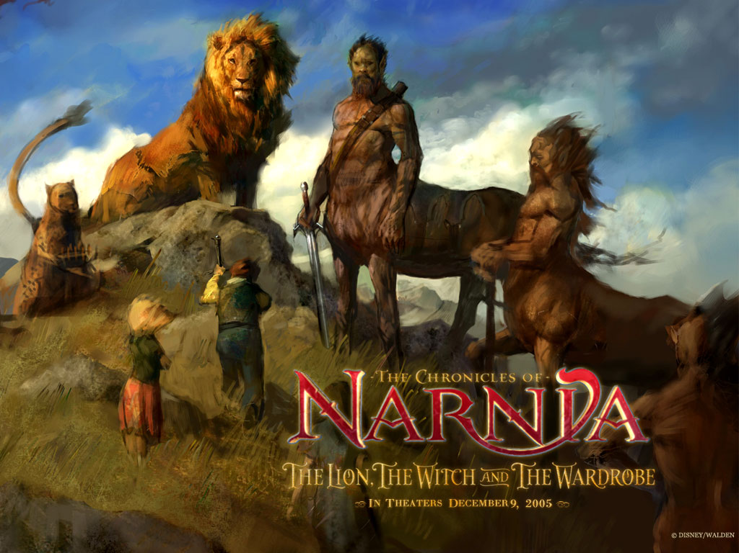
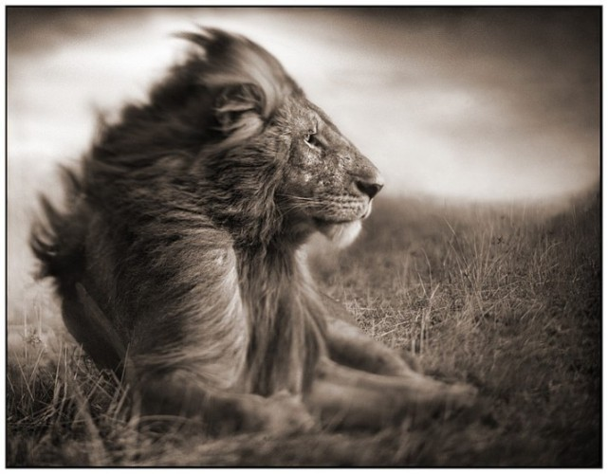


CREDITS
The End

